Slide 1
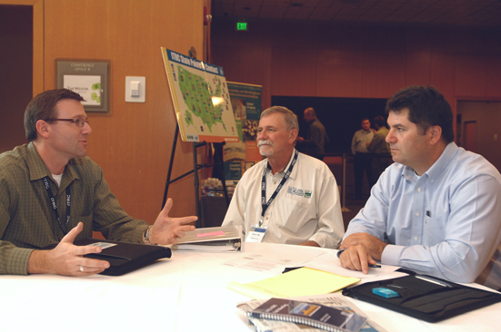
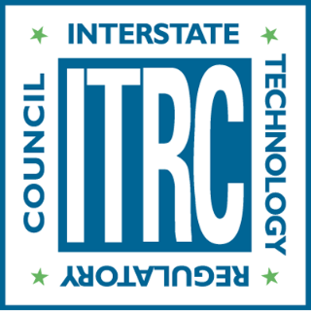
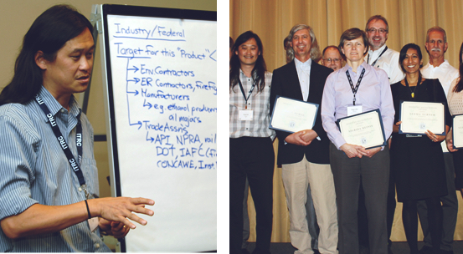
Advancing
Environmental
Solutions
How ITRC Reduces Regulatory Barriers to Innovative Environmental Technologies
www.itrcweb.org

Slide 2
What is ITRC?
ITRC is a state-led coalition working to advance the use of innovative environmental technologies and approaches. ITRC’s work translates good science into better decision making.
Better Environmental Protection
Environmental Regulations
New Technology
Notes:
ITRC is a 501(c)3 program of the Environmental Council of the States (ECOS) and is based in Washington DC. ITRC provides information resources on technically-sound innovative solutions to environmental challenges. Part of ITRC’s mission is to foster integration of new beneficial technical developments within existing regulatory frameworks.
ITRC is a state-led coalition of state regulators, industry experts, public/tribal stakeholders, academia, and federal partners that works to achieve regulatory acceptance of innovative environmental technologies and approaches. ITRC consists of 50 states (and the District of Columbia and Puerto Rico) and works to break down barriers and reduce compliance costs, making it easier to use new technologies and helping states maximize resources. ITRC resources expedite quality decision making, while protecting human health and the environment.

Slide 3
ITRC Values
Integrity
Consensus
Technical
Excellence
Change
Innovation
Partnership
Collaboration
Notes:
ITRC Values
Our values represent enduring beliefs that are at the core of ITRC and serve to guide and shape decisions at all levels of the ITRC organization. We believe that change creates opportunity to implement innovative solutions resulting in protection of human health and the environment. Our approach to developing these solutions is to work as a state-led organization in collaboration with all those affected by the guidance we develop. We believe in taking a path that brings innovation to the environmental marketplace. We believe our products must be grounded in technical excellence that will lead to more capable customers. We expect all to work with integrity so that we may operate in a culture of openness and partnership with our customers and funding sponsors. We strive for consensus in decision making and development of products.

Slide 4
Purpose and Mission
ITRC Purpose
To advance innovative environmental decision making.
ITRC Mission
To develop information resources and processes to break down barriers to the use of technically sound innovative solutions for healthy communities, economy, and environment.

Slide 5
Key Strategies
ITRC looks ahead to future environmental challenges and is ready to focus our resources on developing innovative solutions to address those challenges.
ITRC develops quality products that meet the needs of our customers.
ITRC conducts outreach to demonstrate our value and increase our visibility to funding sponsors.
ITRC emphasizes collaboration and cooperation in our work as a way to foster consensus.

Slide 6

ITRC’s Role
Innovative Technologies and Approaches
Barriers to use:
Lack of knowledge/trust
Differing procedures
Pre-specified approaches
Institutional resistance
Faster acceptance of innovative technologies
Better decision making
Reduced permitting/review time
Decreased compliance costs
Harmonized state approaches

Slide 7
ITRC Role in the
Environmental Community
Reduce barriers
Improve the environment
Provide a national consensus
To the use of innovative environmental technologies
By educating on innovative environmental technologies
On approaches to implementing innovative environmental technologies
Notes:
Why are innovative environmental technologies/approaches important? Innovative environmental technologies/approaches are (1) typically more cost-effective and efficient than traditional approaches and (2) can provide a solution for a problem where no solution previously existed. Barriers exist to using innovative environmental technologies, including (1) lack of understanding or trust in the benefits of the innovative technology; (2) different sets of procedures and/or data requirements among states; (3) institutional resistance to change; and
(4) regulatory inflexibility or pre-specified approaches.
ITRC works to break down barriers by (1) increasing state regulators’ understanding and confidence in innovative technologies/approaches; (2) producing guidance documents and training that are used by environmental professionals across the country to increase regulatory consistency from state-to-state; (3) fostering integration of new technical developments within existing regulations; (4) creating networks of technical experts for use by states when making decisions on innovative environmental technologies/approaches; (5) showing the cost and time savings that can be achieved with innovative environmental technologies/approaches.

Slide 8
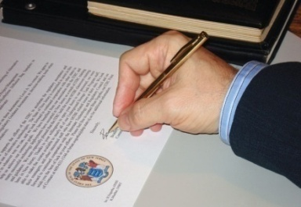

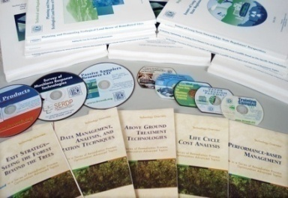


What ITRC Does
Implement solutions
Conduct training and outreach
Develop documents, trainings, and other products
Since 1995:
123 documents (including guidance documents, fact sheets, and case studies);
84 training courses
Form
teams
Select projects
Notes:
ITRC develops guidance documents and training courses using multi-sector teams of experts. All teams are state-led and include a minimum of 5 state team members. The free documents are distributed around the country and associated free training courses are offered through the internet and in classroom settings. One unique and powerful aspect of ITRC products is that they are reviewed and edited by ITRC’s national network of hundreds of state regulators, as well as other ITRC members from federal agencies and the private-sector. Thus, ITRC guidance documents and training truly provide a national perspective.

Slide 9
Focus Areas
Air
  Methane Detection
Water
  Stormwater BMPs
Waste
Remediation
  Bioavailability in Contaminated Soil
Notes:
Long list of topics:
Triad, SCAPS, Diffusion/passive samplers, Direct push wells,
Brownfields, Land use controls, Ecological enhancements, Ecological land reuse
Alternative landfill covers, Landfill bioreactors, Post-closure care at landfills
DNAPLs characterization, monitoring, and remediation approaches, DNAPL surfactant/cosolvent flushing
In situ bioremediation, Bioremediation of DNAPLs, Monitored natural attenuation, Enhanced attenuation
In situ chemical oxidation, Permeable reactive barriers, Thermal desorption
LNAPLs natural depletion, LNAPLs characterization, monitoring, and remediation approaches
Metals treatment, Natural attenuation of metals and radionuclides
MTBE, Perchlorate, Radionuclides
Phytotechnologies, Wetlands
Remediation Process Optimization and Risk Management
Risk assessment
Munitions, UXO, and small arms firing ranges
Vapor Intrusion

Slide 10
ITRC Has Impact
National network with 900 members from 50 states
Published 123 documents
Developed 84 training classes
Trained over 160,000 people
ITRC’s website gets 9,000 to 10,000 unique visitors per month

Slide 11
Power of ITRC’s Unique Network
ECOS and ERIS
Federal Government
State Government
Public and Tribal Stakeholders
Industry
Academia
Notes:
ITRC has a unique network that includes regulators and the regulated, from the government and private sector.
ITRC is a program of ECOS – the Environmental Council of States (national organization of state environmental agency commissioners) – and ERIS (Environmental Research Institute of the States) and ECOS staff provide administration for ITRC.
All ITRC Teams have a minimum of 1-2 state Team Leaders and 5 state members.

Slide 12
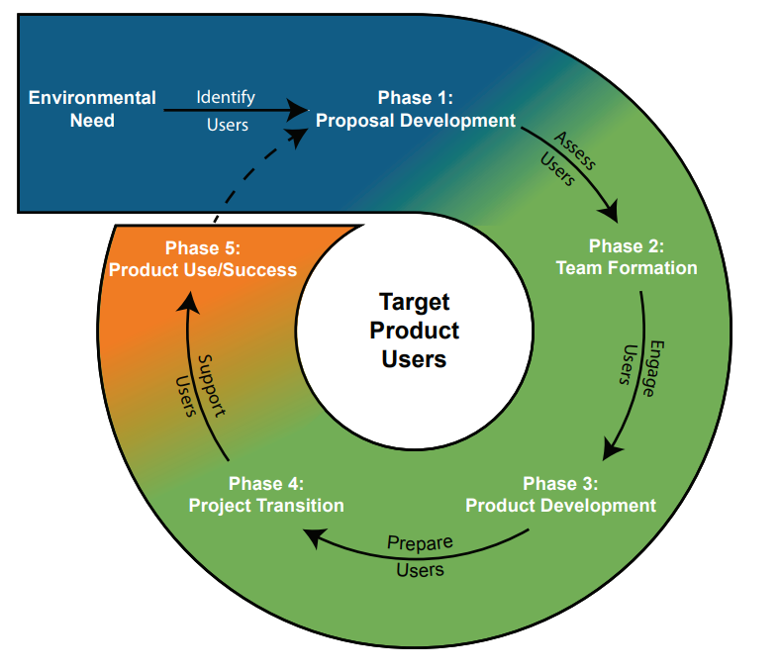
Typical Project Life Cycle

Slide 13
2018 Teams
Optimizing In Situ Remediation Performance & Injection (NEW)
Strategies and Implementing the Use of Advanced Site Characterization Tools (NEW)
Evaluation of Innovative Methane Detection Technologies
LNAPL Update
PFAS
Quality Considerations for Multiple Aspects of Munitions Response Sites
Stormwater BMP Performance Evaluation Team
TPH Risk Evaluation at Petroleum-Contaminated Sites
Notes:
13

Slide 14
What Does ITRC Achieve?
Accomplishments
Educates state regulators on the use of innovative technologies
Benefits
Harmonized state approaches to environmental issues across the nation
Encourages a common language for complex topics
Replaces adversarial relationships with collaboration
Achieves national paradigm shifts for using new technology
Consistent approach to using innovative technology
Faster decision-making
Reduced permitting time
Decreased costs
Leveraging of partnerships
Increased efficiencies
Notes:
ITRC works to break down barriers by (1) increasing state regulators’ understanding and confidence in innovative technologies; (2) producing guidance documents and training that are used by environmental professionals across the country to increase regulatory consistency from state-to-state; (3) fostering integration of new technical developments within existing regulations; (4) creating networks of technical experts for use by states when making decisions on innovative environmental technologies; and (5) showing the cost and time savings that can be achieved with innovative environmental technologies.

Slide 15
ITRC Reduces Barriers
Providing guidance and training developed for state regulators by state regulators
Increasing understanding and confidence in innovative technologies
Fostering integration of new technical developments within existing regulations
Showing the cost and time savings that can be achieved with innovative environmental technologies
Creating networks of technical experts for use by states when making decisions on innovative environmental technologies

Slide 16
Specific Benefits
National paradigm shifts for using new technology
Harmonized approaches to using innovative technology across the nation
Increased regulatory consistency for similar environmental problems in different states
Reduced review/permitting times for innovative approaches to environmental problems
Faster decisions due to reduction in uncertainty
Decreased compliance costs

Slide 17
2017 Membership Distribution
Notes:
Over 900 members total, 45% private sector, 45% government

Slide 18
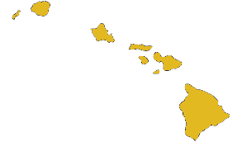
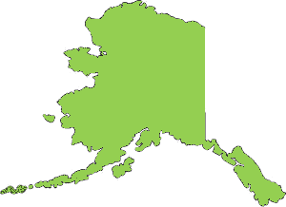
2017 Geographic Distribution of State Membership
10 + members
5-9 members
3-4 members
1-2 members
0 members
100% of states have 1 or more members
Notes:
ITRC has one of the deepest, if not the deepest, network of state environmental regulators available. Because of ITRC’s reach into the state environmental agencies, its guidance documents and training truly represent a national perspective. One benefit of this national perspective is harmonization of state regulatory approaches across the nation. Another is that ITRC is a powerful state network that can be used by states to maximize their resources.
For example, states without technical experts in emerging areas can use ITRC’s network as a resource for addressing technical challenges and decision making on innovative environmental technologies/approaches.

Slide 19
2017 Industry Affiliates Program

Slide 20
2018 Planned Products
Project/Team | Tech Reg Document | Online Training
LNAPL Update | ● | ●
Quality Considerations for Multiple Aspects of Munitions Response Sites | ● | ●
Evaluation of Innovative Methane Detection Technologies | ● | ●
Stormwater BMPs | ● | ●
TPH Risk Evaluation at Petroleum-Contaminated Sites | ● | ●
Notes:
20

Slide 21


Training
FREE Online Training
Classroom Training
See www.itrcweb.org for full schedule
Notes:
ITRC training is based on ITRC technical and regulatory guidance documents and focused on increasing understanding and use of ITRC documents. Internet-based training is hosted in conjunction with EPA’s Clu-in Website and is free (and cost-effective, since no travel is required). Most internet-based training courses are available in archived form for on-demand viewing. ITRC offering Vapor Intrusion classroom training in Michigan October 2017. See www.itrcweb.org for more information.

Slide 22
Training: 1997-2016
Notes:
As of mid-2017: over 160,000 people trained since 1997

Slide 23
Training: 1997-2016
Notes:
As of mid-2017: over 160,000 people trained since 1997

Slide 24
PVI Classroom Training
An intensive two-day course: “Vapor Intrusion Pathway - A Practical Guideline”
Course Overview
  How to conduct site screening and investigations
  How to collect quality data and evaluate the results
  How to apply multiple lines of evidence to ensure quality decision making
  Understanding and implementing mitigation options
  Stay tuned for 2018 PVI Classroom Training details!

Slide 25
2018 ITRC Courses
Quality Considerations for Multiple Aspects of Munitions Response Sites
Remediation Management of Complex Sites
Bioavailability of Contaminants in Soil: Considerations for Human Health Risk Assessment
Characterization and Remediation in Fractured Rock
Groundwater Statistics for Environmental Project Managers
Petroleum Vapor Intrusion: Fundamentals of Screening, Investigation, and Management
Geospatial Analysis for Optimization at Environmental Sites
Long-term Contaminant Management Using Institutional Controls
Remedy Selection for Contaminated Sediments
Issues and Options in Human Health Risk Assessment – A Resource When Alternatives to Default Parameters and Scenarios are Proposed
Integrated DNAPL Site Characterization
Use and Measurement of Mass Flux and Mass Discharge
Geophysical Classification for Munitions Response
Integrated DNAPL Site Strategy
LNAPL Parts 1, 2, & 3
See www.itrcweb.org/training for the full schedule

Slide 26
State Engagement Network
ITRC is led by state agency representatives through its Board of Advisors
States become official members of ITRC by appointing a Point of Contact (POC). The POCs:
  Facilitate communication within the state
  Identify state priorities and emerging issues
  Coordinate state review of draft documents and dry run training
  Promote use of ITRC documents and training within the state
Each ITRC Team is led by 1-2 state agency Team Leaders and has a minimum of 5 state agency team members
Notes:
The POC Network is one of ITRC’s more important features. ITRC has one of the deepest, if not the deepest, network of state environmental regulators available. Because of ITRC’s reach into the state environmental agencies, its guidance documents and training truly represent a national perspective. One benefit of this national perspective is harmonization of state regulatory approaches across the nation. Another is that ITRC is a powerful state network that can be used by states to maximize their resources. For example, states without technical experts in emerging areas can use ITRC’s network as a resource for addressing technical challenges and decision making on innovative environmental technologies/approaches.

Slide 27
1995
ITRC Member
2005
2017
Notes:
State membership over time.
States without POCs assigned: none!
Puerto Rico joined in 2010
Thanks to the affiliation with ECOS in 1999 (when ITRC administration was transferred from Western Governors Association (WGA) to ECOS) we saw a significant increase in state membership

Slide 28
State Engagement
In 2017, all 50 states, DC, and Puerto Rico have confirmed Points of Contact (POCs)
POCs:
  Review ITRC documents
  Submit state environmental priorities to ITRC
  Respond to survey requests
  Indicate expected level of participation in ITRC proposed projects
  Participate in training dry runs
  Contribute to project technical and implementation sessions
  Submit ITRC success stories
  Recruit state Team Leaders and members for ITRC Teams
  Provide state concurrence on ITRC technical regulatory guidance documents
Notes:
The number of POCs reflects upon ITRC reach into the state environmental agencies. ITRC has a deep state network as a minimum of 80% of states appoint ITRC POCs, which act in a 2-way communication role between states and ITRC. The main role of the ITRC POC is to increase use of ITRC documents and training. However, they also contribute in a number of other important ways listed in this slide.

Slide 29
Benefits to States
Information and technology transfer – states make ITRC guidance their own
Free training and knowledge on how to use innovative environmental technologies/approaches
Access to peers and experts in other regulatory agencies
Shortened learning curve by obtaining advance knowledge of innovative technologies/approaches
Cost-effective involvement in demonstrations conducted in other jurisdictions
Sounding board for problem solving
Leadership and professional development

Slide 30
Federal Government Participation
ITRC partners with U.S. government agencies:
  Environmental Protection Agency (EPA)
  Department of Defense (DOD)
  Department of Energy (DOE)
Collectively EPA, DOD, and DOE:
  Have partnered with ITRC since 1995
  Are members of the ITRC Board of Advisors
  Provided about 70% of ITRC’s budget in 2016
  Provide peer review of ITRC documents and training courses
  Provide technical experts for ITRC teams
  Provide instructors for ITRC training courses
  Play an active role in future project selection
  Take ITRC training courses

Slide 31
Benefits to DOD and DOE
Encourages use of innovative environmental solutions
Increases reliance on cost-effective approaches
Reduces review and approval times for innovative approaches to environmental problems
Facilitates interactions between federal managers and state regulators
Increases consistency of regulatory requirements for similar environmental problems in different states
Can help reduce uncertainties when preparing plans
Addresses DOD and DOE unique environmental needs (e.g. munitions, radionuclides, chlorinated solvents)

Slide 32
Benefits to EPA
Provides knowledge transfer to states for better environmental protection
Encourages use of innovative environmental solutions by states and others
Increases state reliance on cost-effective approaches
Facilitates idea sharing between federal managers and state regulators
Provides a mechanism for identifying and integrating regulatory performance expectations among states
Unique and cost-effective approach for demonstrating and deploying new technology/approaches

Slide 33
Private Sector Participation
  Has partnered with ITRC since 1995
  Is part of the ITRC Board of Advisors
  Provided about 30% of the ITRC’s budget in 2016
  Provides peer review of ITRC documents and training courses
  Provides technical experts for ITRC teams
  Provides instructors for ITRC training courses
  Plays an active role in future project selection
  Takes ITRC training courses

Slide 34
Benefits to the Private Sector
Cutting-edge information on innovative environmental technologies and approaches
Opportunities to author national guidance documents and participate in training courses
Insight into the regulatory world
Access to multiple state and federal government entities
Opportunity for broader review of technology
National approach to demonstration and deployment of new technology
Mechanism to identify and integrate regulatory performance expectations among states

Slide 35
How Can You Get Benefit From ITRC?
Use the ITRC documents (www.itrcweb.org)
Take a training course (internet or classroom)
Join an ITRC team and help write documents and develop training courses
Contact your State POC through your state environmental agency

Slide 36
Where Are We Going?
What type of new training technologies and approaches are possible?
What can we do to improve our website and make the most of social networking?
What emerging areas should we consider for projects within the cleanup area and outside of cleanup area?
Notes:
Some of these questions may require ITRC to change.

Slide 37
Outreach
Everyone in ITRC “does outreach”
  ITRC provides basic tools, but members are responsible for outreach in whatever capacity they can provide.
  Communication with commissioners/directors of state environmental agencies and federal funders is a high priority for ITRC leadership.
  Look for outreach opportunities—if you need support let ITRC know.
  An essential part of outreach is reporting back success stories so we can measure our impact.
Notes:
ITRC is a great organization and everyone should feel comfortable talking about it with their peers. ITRC has beefed up its outreach page and materials available to members, as well as encouraged members to present at conferences. ITRC leadership is actively engaging with ECOS commissioners, including direct communication through ECOS-only newsletters. Plans are in the works to provide commissioners with “tool kits” on how to best implement ITRC within their state. Additionally, a strong effort for outreach to funders is planned.

Slide 38
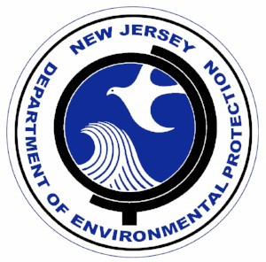
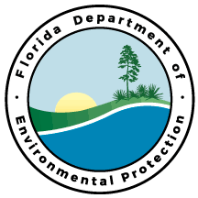
Recent State Successes
New Jersey Department of Environmental Protection
NJ DEP recently completed a new guidance document entitled In Situ Remediation: Design Considerations and Performance Monitoring Technical Guidance Document. The new guidance document references ITRC extensively; in the reference section, 14 ITRC documents are listed and ITRC documents are referenced throughout the document.
Florida Department of Environmental Protection
FL DEP updated a rule for contaminated site cleanup criteria (62-780, Florida Administrative Code) in February of this year. The ITRC Incremental Sampling Methodology (ISM) guidance document is listed as the official guidance document under Rule 62-780.100(21) for ISM sampling.

Slide 39
Success Stories

Slide 40
National Guide for Vapor Intrusion
32 states report use of ITRC’s Vapor Intrusion guidance document in at least one of the following ways:
  As a basis to develop state guidance
  As a reference within state guidance
  As a tool to directly assist with site activities
  As a resource for state staff and consultants/contractors
ITRC has trained over 4,600 people from across the nation on vapor intrusion (42% are state regulators)!
“Since participating in ITRC Maine will likely adopt the ITRC vapor intrusion tech-reg as the default.”
– Fred Lavallee, ME
Notes:
One of ITRC’s most significant benefits is that ITRC guidance document text can be used with confidence by states when crafting or implementing their own guidance. This saves time and money for states since they don’t have to reinvent the wheel and can use ITRC-reviewed language directly into their own documents. Additionally, harmonized state regulatory approaches across the country benefits everyone.

Slide 41
ITRC Aids in Fairbanks Cleanup
Employing the ITRC Environmental Molecular Diagnostic (EMD) guidance document, Internet-based training course, and fact sheets, regulators in Alaska have approved the use of EMDs at remediation sites throughout the state.
Benefits of EMDS
  Understand the Extent of Biodegradation
  Determine Microbe Distribution, Abundance, and Activity
  Develop Targeted Treatment Plans
  Identify Contamination Sources

Slide 42
Innovative Solutions for Lead Contamination
Over $10 million saved at Lackland Air Force Base in Texas by using ITRC’s recommended innovative approaches to treating lead-contaminated soil
  Staff from Texas Commission on Environmental Quality and Lackland Air Force Base in Texas used ITRC’s documents and training to develop an innovative treatment approach for soil contaminated by lead from small arms training.
  Lead contaminated soil was stabilized using a solid binder, which prevents the lead from migrating; the stabilized soil was then used as a landfill cover and in berms for active firing ranges.
  Significant cost savings was achieved through avoidance of transportation and disposal costs and elimination of the need to purchase new soil.
Notes:
State regulators involved with federal facilities cleanup use ITRC guidance documents to develop innovative and cost-effective solutions to waste problems. Here, use of ITRC’s document and associated training titled, “Characterization and Remediation of Soils at Closed Small Arms Firing Ranges” showed how to clean up former firing ranges to save time and money for the state of Texas and the Air Force. In this example, TX CEQ was able to save DOD over $10 million, but also reduced their own staff time spent on the site since they had the ITRC materials as a guide.

Slide 43
Innovation Cuts Costs
ITRC’s documents and training on passive diffusion bag samplers and direct push wells have ushered use of these innovative solutions that provide a substantial cost savings
  Passive diffusion bag samplers replace traditional sampling approaches with a cost reduction between 40-70%, depending on DQO’s.
  Direct push wells replace auger-drilled wells for a cost savings of about 50% depending on depth.

Slide 44
Breaking Down Regulatory Barriers
ITRC helps remove regulatory barriers to in situ bioremediation!
  RCRA 3020(b) required that contaminated groundwater be, “treated to substantially reduce hazardous constituents prior to injection” —a costly and time-consuming process.
  Using case histories, ITRC’s In Situ Bioremediation Team showed that amending contaminated groundwater with appropriate bioremediation substrates allowed it to be safely injected (contaminants were biodegraded).
  California and 14 other ITRC member states requested that US EPA clarify RCRA 3020(b).
  RCRA 3020(b) was reinterpreted by US EPA to allow for contaminated groundwater to be amended and injected, where it promotes clean up, while reducing the accumulation of wastewater.
Notes:
Stimulating enhanced in situ bioremediation by extracting contaminated groundwater, amending it with appropriate bioremediation substrates, and re-injecting the mixture back into contaminated aquifer is a cost-effective and efficient way to treat a site. This approach works well with traditional groundwater pump and treat systems and can increase their effectiveness substantially. RCRA 3020(b) was a barrier to using this innovative approach since extracted groundwater that contained contamination could not be re-injected unless the contamination was removed.
ITRC’s In Situ Bioremediation Team supported amending contaminated groundwater with additives, such as organic carbon, nutrients, electron acceptors and/or microbial cultures and re-injecting the amended groundwater to enhance in situ bioremediation of the contaminants. The basis of ITRC’s support for this approach was environmental soundness – the inherent similarity of the re-injected groundwater to the remaining groundwater in the aquifer and the ability to promote cleanup, while reducing the accumulation of waster water. ITRC’s work catalyze the removal of regulatory barriers to enhanced in situ bioremediation has allowed hundreds of in situ bioremediation projects to move forward, with millions to tens of millions of dollars in cost savings.

Slide 45
Educating on Risk Assessment Software
ITRC’s Risk Team increases state regulator use of risk assessment software packages
  ITRC’s Risk Team partnered with US Army Corps of Engineers and the Army Environmental Command (AEC) to evaluate widely-used risk assessment software packages (ARAMS and SADA).
  In October 2008, ITRC held a training and technology transfer workshop with several hundred state regulators and others on the software packages.
  ITRC’s Risk Team work has greatly increased state regulators knowledge and use of risk assessment software packages.

Slide 46
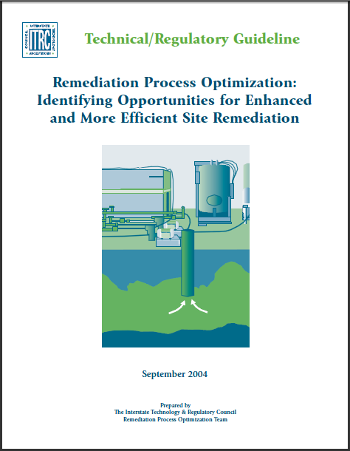
Remedial Process Optimization
ITRC’s documents on Remedial Process Optimization (RPO) have saved time and money at numerous DOD facilities (average savings of $1 million per site).
DOE has conducted 8 RPOs since 2004 at Hanford and Paducah, saving 10’s of millions of dollars in remedial efficiency and effectiveness.
RPO teams included members from DoD Military Services and SERDP/ESTCP to further facilitate tech transfer from DoD to DOE.
Notes:
The Air Force’s Remedial Process Optimization program (called ERP-O – Environmental Restoration Program Optimization) uses ITRC documents, along with teams of state regulators and other experts, to optimize clean up at Air Force facilities. Because the process is based on ITRC’s documents and state regulators are participating, the optimization is accepted more rapidly on the state-side.
Examples: Altus, Andersen, Tyndall, Kelly, KI Sawyer, Pease, Myrtle Beach, McGuire, MMR
DOE has conducted 8 RPOs since 2004 at Hanford and Paducah saving 10s of millions of dollars in remedial efficiency and effectiveness, as well as streamlining emerging technologies from the DoD SERDP&ESTCP DNAPL portfolio to those sites for cleanup up of soil and groundwater. The RPO teams contained members from DoD Military Services and SERDP/ESTCP to further facilitate tech transfer from DoD to DOE.

Slide 47
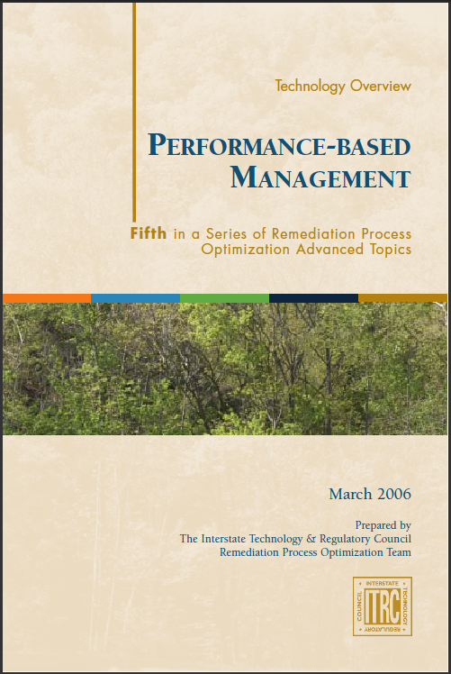
Expedited Corrective Action Processes
ITRC documents on performance-based environmental management catalyzed cleanup at Altus Air Force Base in Oklahoma.
  Environmental restoration was stalled since 1996 due to disagreements between the Air Force, Oklahoma Department of Environmental Quality, and US EPA Region 6 regarding chlorinated solvent cleanup levels.
  Project managers from all three organizations used ITRC’s documents and training on exit strategies to co-develop and agree upon remedial objectives.
  The agreed upon remedial strategy was implemented in December 2007, with a stated time savings of 5 years.
Notes:
ITRC documents can be used for collaboration by parties that were formerly in opposition. For example at Altus AFB in OK, state and federal regulators were able to work with DOD staff by using ITRC’s remedial process optimization documents (specifically “Exit Strategy: Seeing the Forest Beyond the Trees” and “Performance-Based Management”) to implement a cleanup process after work at stalled for nearly 8 years. The solution was rapidly implemented, with a time savings of 5 years.

Slide 48
Performance-Based Management
Many private and public sector organizations use ITRC’s Performance-Based Environmental Management documents to expedite the acceptance and implementation of cleanup plans For example:
  ProLogis, a distribution and warehousing corporation, and the state of California completed site cleanup of a 22 acre facility 4 months ahead of schedule by agreeing on a site conceptual model and cleanup plan .
  At Lackland Air Force Base, the state of Texas and base staff plan to close 70 waste sites three years ahead of the Air Force Remedy in Place 2012 deadlines.

Slide 49
Benefiting Restoration at DOE Sites
US Department of Energy (DOE) gets great value in ITRC documents and training:
  ITRC resources have aided in expedited environmental restoration of chlorinated solvents, metals, and radionuclides at DOE’s Savannah River Site in Aiken, SC, a complex site consisting of 515 waste sites and a 35 year cleanup plan.
  ITRC documents and training on Remedial Process Optimization have been used at DOE’s Hanford site in Washington and Paducah site in Kentucky to improve and streamline the cleanup.
“ITRC participation is instrumental in facilitating regulatory acceptance of innovative technologies through direct experience, as well as networking with regulators”
– Don Siron, Federal Facility Agreement Section, SC DHEC

Slide 50
Other Success Stories
Seneca Army Depot – New York
  Site manager used ITRC’s Permeable Reactive Barrier documents to develop the state remediation application and work plan.
  Process accelerated, simplified, and improved NY DEC’s ability to review and approve the application.
Former Rocky Mountain Arsenal – Colorado
  ITRC’s UXO documents and training courses were used by the state of CO to improve understanding of munitions response projects.
  Result was a better working relationship with Army representatives during the cleanup process.

Slide 51
US EPA Supports ITRC
US EPA supports ITRC, noting the following in an email to ITRC:
  “ITRC is a great venue for increasing mutual understanding and collaboration between states and EPA.”
  “ITRC is a way to communicate new and improved strategies to a large audience at once, bringing a large segment of the cleanup community along together.”
  “The result is a much faster adoption of new technologies and rapid spread of new knowledge and research findings.”

Slide 52
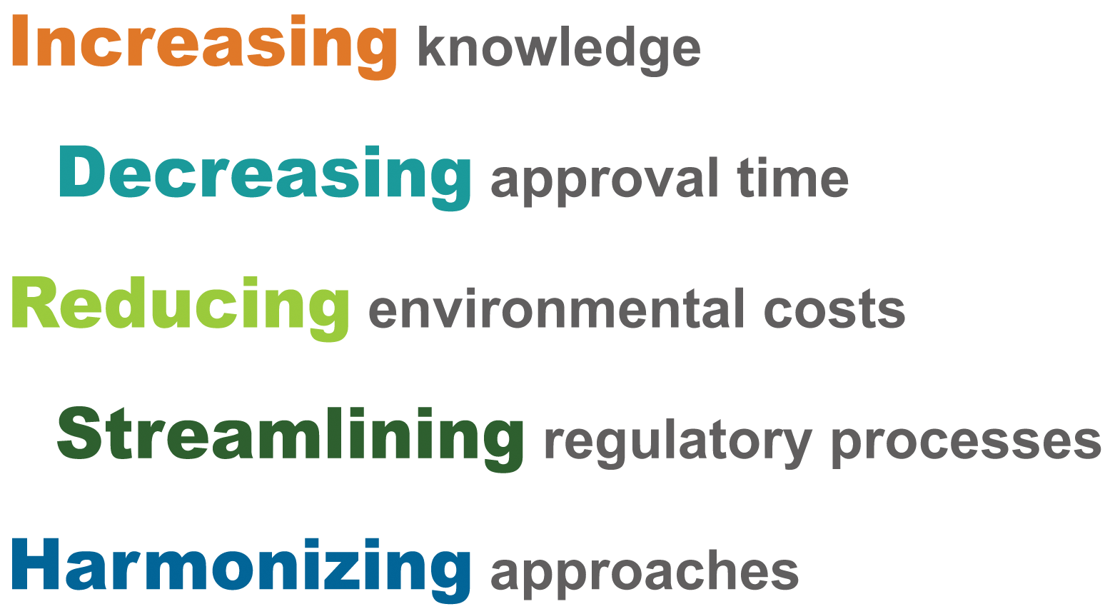
ITRC Represents

Slide 53

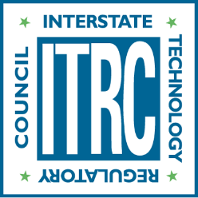


Thank you!
Stay updated on ITRC’s activities:
itrcweb.org
facebook.com/itrcweb
@ITRCWEB
linkedin.com/
company/itrc

