Slide 1
2017 ITRC Annual Meeting award winners

Slide 2
Team leaders of the year
Carl Spreng & John Price III Remediation Management of Complex Sites

Slide 3
2016 Team of the year
Bioavailability in Contaminated Soil
Team Leaders: Kathryn Durant and Claudio Sorrentino

Slide 4
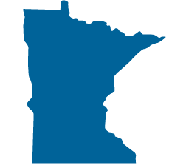
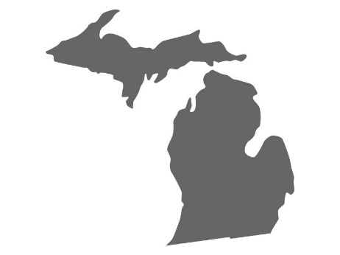
POC awards
Outstanding Service:
Outstanding Performance:
Great Beginnings:
Rebecca Higgins
Sara Pearson
Joey Pace

Slide 5
Stakeholder awards
Stakeholder Recognition:
Stakeholder of the Year:
David Lyon – Methane Detection
Jeff Heinzman – Complex Sites
Jeffrey Short – Stormwater and Institutional Controls

Slide 6
Industry recognition awards
Jose Gomez-Eyles Bioavailability
Seema Turner Fractured Rock
Sigrida Reinis Methane Detection
Adam Janzen
Geostatistics
Eric Nichols LNAPL
Doug Burge Institutional Controls
Jim Pastorick Munitions
Chuck Newell Complex Sites
Vitina Mandella Stormwater BMP
Jeff Tyson TPH

Slide 7
2017 ITRC Annual Meeting Lifetime achievement

Slide 8
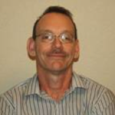
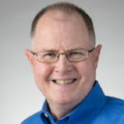
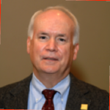
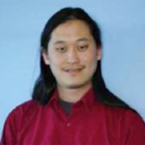
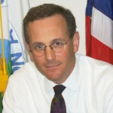
Lifetime Achievement Nominees
Jim Harrington
Michael Murphy
Jeff Heimerman
Charles J. Newell, PE, PhD
Dr. David Tsao

Slide 9
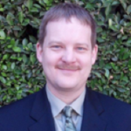
Congratulations 2017 lifetime achievement Award winner – tom Schneider!
Involved with ITRC since 1998
Served on multiple teams and Team Leader for 2 Radionuclides Teams
Ohio POC
Board At-Large State Representative in 2012
Co-Chair 2013 to April 2017 overseeing major enhancements (Strategic Plan, Remediation Plus, new federal partners and ERIS restructuring)
Represented Ohio on various national organizations addressing cleanup of federal facilities including State and Tribal Governments Working Group, National Governors Association Federal Facilities Task Force, and ECOS Federal Facilities Forum
Ohio Trustee representative implementing largest natural resources damages settlement against the federal government for contamination at Fernald
Currently Federal Facilities Program Administrator in the Division of Environmental Response and Revitalization

