Slide 1
Louisiana Department of Environmental Quality – 2017
Chuck Carr Brown, Ph.D. – Secretary

Slide 2
Environmental Research
Understanding Environmentalism among African Americans, a Test of the Theoretical Explanations.

Slide 3
EEAT Philosophy
Environmental Education
Access to Decision Makers
Trust in the Decisions that are Made

Slide 4
Environmental Justice Definition
There are many!
What Can Industry do in order to enhance your quality of life?
Job Training
Health Screening
Early Warning Systems
Air Monitoring

Slide 5
Environmental Justice Community
What is an Environmental Justice Community?
Chicken or the Egg? ExxonMobil 1909
Alsen
Mossville
Oakville

Slide 6
Environmental Justice Community
Abandoned Coal Mines
Buy out Programs
Brownfields

Slide 7
Community Engagement Path Forward
EPA Headquarters Commitment
Long term impact of New Federal Administration
Citizen Advisory Committees
Practice Win-Win
Beneficial Environmental Projects

Slide 8
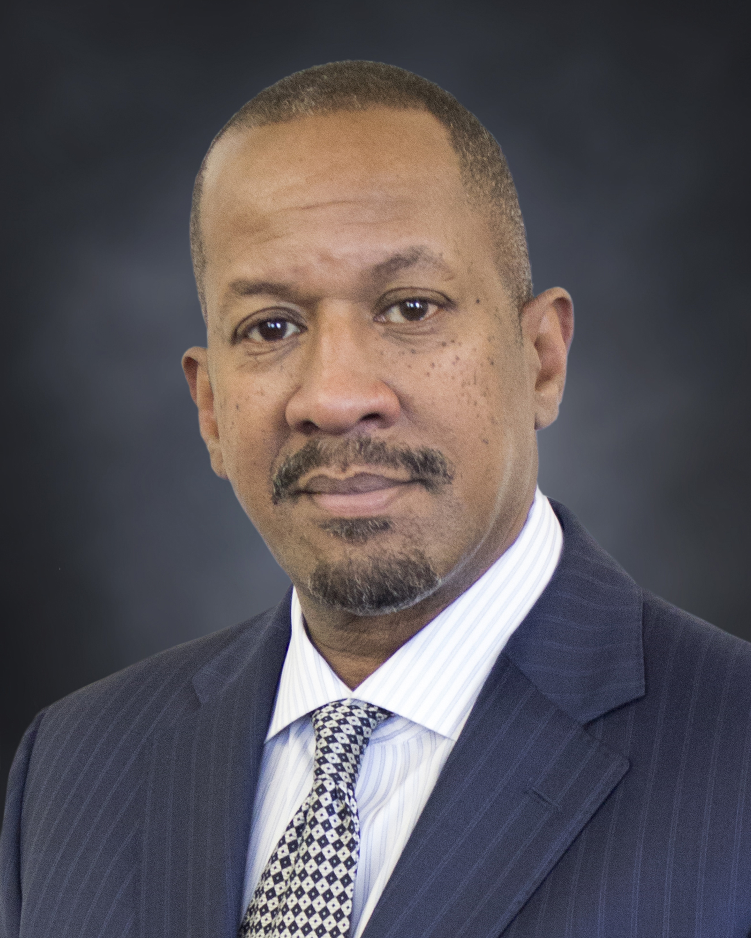
Contact Information
Chuck Carr Brown, Ph. D.
225-219-3950
chuck.brown@la.gov
DEQ Web site
www.deq.louisiana.gov

Slide 9
The issue of proximity
Chuck Carr Brown, Ph.D. – Secretary

