Slide 1
2017 ITRC Annual Meeting Remediation Management of Complex Sites Implementation Update

Slide 2
Remediation Management of Complex Sites
John Price, Team Leader, Washington
Carl Spreng, Team Leader, Colorado
Rula Deeb, Program Advisor

Slide 3
background/overview
THE PROBLEM
Reaching remediation objectives remains a significant challenge at many complex sites
Conventional remedies and approaches are difficult to apply National Research Council reported 126,000 sites have residual contamination, have not achieved site closure
Roughly 10% of these sites are “complex”
$127 billion “cost to complete”

Slide 4
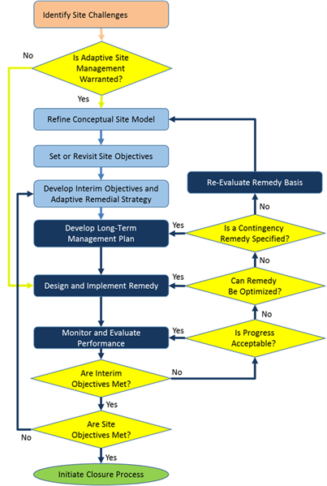
Implementation Objective
THE SOLUTION: ADAPTIVE SITE MANAGEMENT
Better and faster decision-making
Minimal gathering of unnecessary data
Ineffective remedial technologies ruled out
More sustainable remedy, reduced footprint, improved cost-effectiveness
Compliance with existing regulations
Protective of human health and environment
Notes:
Adaptive Site Management = a comprehensive, flexible, and iterative approach to remediation

Slide 5
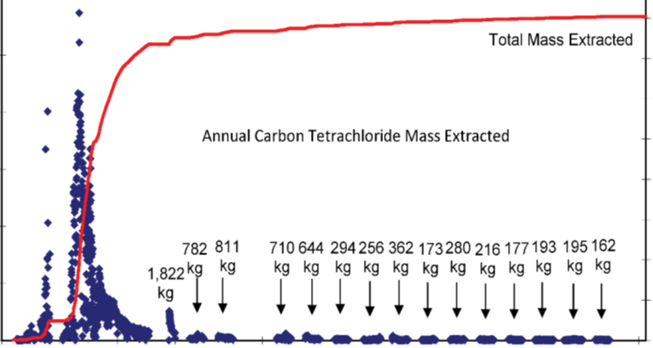
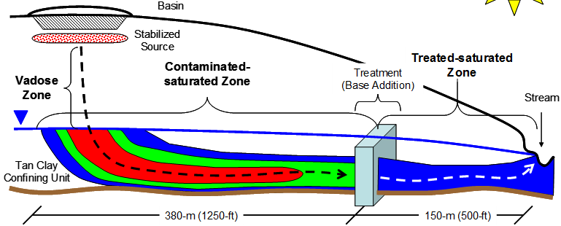
Adaptive Site management approaches
Notes:
ASM approach developed by remediation practitioners with actual site experience utilizing the flexibilities in state and federal policy and guidance.

Slide 6
Implementation Schedule
Team Status
TechReg currently undergoing external review. Expecting comments by May 1, 2017
Team has started developing internet-based training (IBT)
Timeline
TechReg posting date to ITRC website: October 1, 2017
IBT start date: early 2018

Slide 7
2017 ITRC Annual Meeting bioavailability in contaminated soil Implementation Update

Slide 8
Bioavailability in contaminated soil
Claudio Sorrentino
California DTSC
Kathryn Durant
Delaware DNREC
Lesley Hay Wilson
Program Advisor

Slide 9
Background / overview
The bioavailability of contaminants in soil can vary significantly from site to site (and even within a site)
A site-specific evaluation can reduce uncertainty in the risk assessment and help use resources more efficiently
Not used in many projects because of the lack of knowledge of the methods available (and concerns about costs)

Slide 10
challenges
There is no “one-size-fits-all” solution
Different methods available
How do I choose the method?
When to evaluate site-specific bioavailability

Slide 11
benefits
of Site-Specific Bioavailability Evaluation
Reduce uncertainty in risk assessments
(decisions are protective)
Can change remedial decisions
(better use of resources)

Slide 12
Implementation Objectives (1)
Project managers will use the document to:
Determine if site-specific bioavailability is a viable option for their site
Learn about available methods
Decide which method is best suited for their site
Perform / review risk assessment calculations

Slide 13
Implementation Objectives (2)
Highlight the benefits of using site-specific bioavailability using case studies
Arsenic mining, smelting and agricultural sites
Lead industrial site
PAHs former skeet shooting range

Slide 14
Implementation Schedule
Status: Reviewing comments from the external review
Developing the Internet Based Training
Timeline: Guidance & IBT dry run by end of 2017
Implementation: Presentation at Battelle Conf. (May 2017) Abstract Submitted to AEHS (Oct. 2017)

Slide 15
2017 ITRC Annual Meeting Characterization and Remediation of Fractured Rock Implementation Update

Slide 16
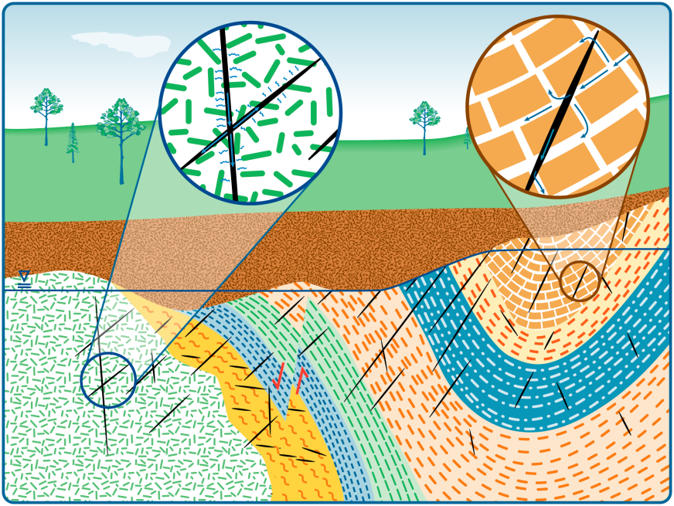
Characterization and Remediation of Fractured Rock
Characterization and Remediation in Fractured Rock
Naji Akladiss
Maine DEP
Michael Smith
Vermont DEC
Steve Hill
RegTech

Slide 17
Background/Overview
While techniques for characterization and remediation of contamination in unconsolidated materials have improved greatly in the last 20-30 years, and are generally well known by regulators, addressing contaminants in fractured rock can be seem more complicated, as well as very expensive.
In many cases remediation defaulted directly to pump and treat.
There have however, been significant advances characterizing and remediating fractured rock, as well as adapting techniques from the oil and gas industry.
The Characterization and Remediation of Fractured Rock guidance works as a platform to help spread these advances and improve how we characterize and remediate contamination in fractured rock.

Slide 18
The Project:
Develop A Technical & Regulatory guidance that
Describes recent advancement in understanding fracture affects on flow and transport of contaminants
Describes latest tools and concepts that are specific to characterizing, remediating, and monitoring fractured rock contaminated sites
Describes the application of treatment and control technologies to remediate fractured rock contaminated sites
Includes a tool & technology selection table of over 100 characterization tools and remedial technologies

Slide 19
Implementation Objective
For our document to make an impact, we need to insure it is widely known.
Take advantage of the ITRC network and have consultants propose techniques and tools in this document to regulators to help them understand that contaminated bedrock can be addressed by more than pump and treat
Take advantage of the POC network. Have POCs advertise internet based (IBT) training sessions and possible set up conference rooms so a number of people can attend the IBT and talk about it afterwards. For instance, a POC could discuss this in a brown bag lunch type setting.
Present short courses and papers at conferences
As budgets for ITRC travel will likely be very low, we can work with, and encourage, former team members who will be at conferences to present the document.
Prepare papers for journals introducing and describing the document

Slide 20
Implementation Schedule
Team Status:
Preparing draft document for external review (4/24/17), & developing IBT
Planned Timeline/Outcome: Document final and posted to web by 11/29/17
Implementation Schedule:
Now: Begin identifying conferences and journals where we can introduce the document
Recruit team members to help introduce the document
Prepare POC’s
On Publication: Finalize IBT and advertise both doc and IBT.
Conferences
Journal papers
POC network

Slide 21
2017 ITRC Annual Meeting Characterization and Remediation of Fractured Rock Team Update

Slide 22
PFAS Team Overview
Team Leaders:
Robert Mueller
New Jersey DEP
Ginny Yingling
Minnesota Dept. Health
Program Advisor:
Lesley Hay-Wilson
Sage Risk Solutions LLC
PFOS

Slide 23
PFAS Team Goal
Understanding in the scientific community of PFAS sources, site characterization, fate and transport and remediation is growing rapidly
PFAS compounds in the environment have become an emerging, worldwide priority
The ITRC PFAS team will produce concise technical resources for project managers – regulators, consultants, responsible parties, and stakeholders
Six Fact Sheets
Web-based Technical and Regulatory Guidance Document
Internet-based Training

Slide 24
2017: Developing Fact Sheets
Six writing subgroups
Led by one state regulator and one other team member – see next
Documents will be available through the team private page
All team members will be able to participate through comments and review
Fact sheets expected to be 10 pages or less

Slide 25
Target Users for Fact Sheets
Primary – state personnel of regulatory programs – project managers for remediation sites, other state project managers
Additional – consultants, industry, and federal project managers; stakeholders

Slide 26
Project Overview
Six Fact Sheets synthesizing key information
History and Use
Nomenclature Overview and Physicochemical Properties
Regulatory Summary
Fate and Transport
Site Characterization Tools, Sampling Techniques and Laboratory Analytical Methods
Remediation Technologies and Methods

Slide 27
Fact Sheet Writing Subgroup Leaders
History & Use
Kate Emma Schlosser, NH
Jeff Hale, Kleinfelder
Nomenclature and Phys-Chem
Tracie White, CO
Elizabeth Denly, TRC Solutions
Regulatory Summary
Brie Sterling, PA
Linda Hall, GSI
Fate & Transport
Sandra Goodrow, NJ
Sarah Gewurtz, GHD
Site Characterization, Sampling Tech., & Lab Methods
Bob Delaney, MI
Janice Willey, Navy
Remediation Technologies
Jamie Wallerstedt, MN
Bill DiGuiseppi, CH2M

Slide 28
Fact Sheet Writing Schedule
Plan for rough outlines before the team meeting (Done!)
First 3 fact sheet drafts to the editor by June 15
Start external review for first 3 fact sheets July 17 (30-day review)
Review complete August 16
Possible team meeting end of August, early September
Publish first 3 fact sheets September 8
Second 3 fact sheet drafts to the editor by September 15
Start external review for second 3 fact sheets October 16 (30-day review)
Review complete November 15
Publish second 3 fact sheets December 8

Slide 29
Project Overview: 2018-2019
Following the release of the Fact Sheets in 2017, develop a detailed, web-based technical and regulatory guidance document and Internet –based training (IBT) course.
Technical information
Necessary breadth and depth not given by Fact Sheets
Links to scientific literature
Regulatory information and links
Stakeholder perspectives
Other related information as determined by the team
Work on outreach opportunities
Team to complete its work by December 2019

